Slide 1

CyVerse Overview and Tutorial
CSHL 2016 Cereal Genomics Course
Jason Williams – Education, Outreach, Training Lead
Cold Spring Harbor Laboratory
williams@cshl.edu @JasonWilliamsNY

Slide 2
Slides and Tutorials
www.cyverse.org/cereal2016

Slide 3

CyVerse Evolution
Vision:
Transforming science through data-driven discovery
Mission:
Design, develop, deploy, and expand a national cyberinfrastructure for life science research, and train scientists in its use
More than 30K users, PB of data, and hundreds of publications, courses, and discoveries
CyVerse 2016
Transforming Science Through Data-Driven Discovery

Slide 4
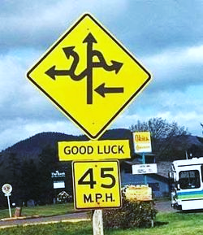
Apologies...
“I had the feeling I have been exposed to many bioinformatics tools but I would be unable to use any of them on my own.”

Slide 5
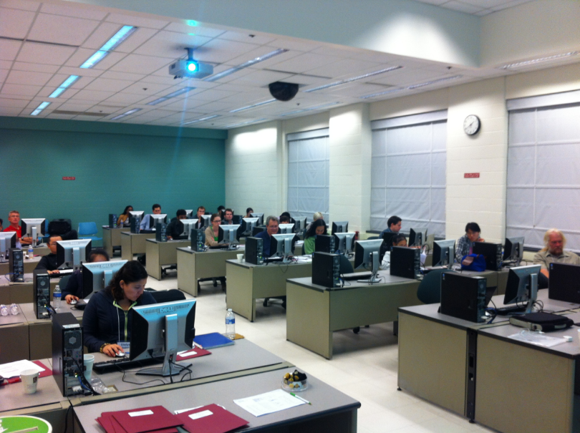
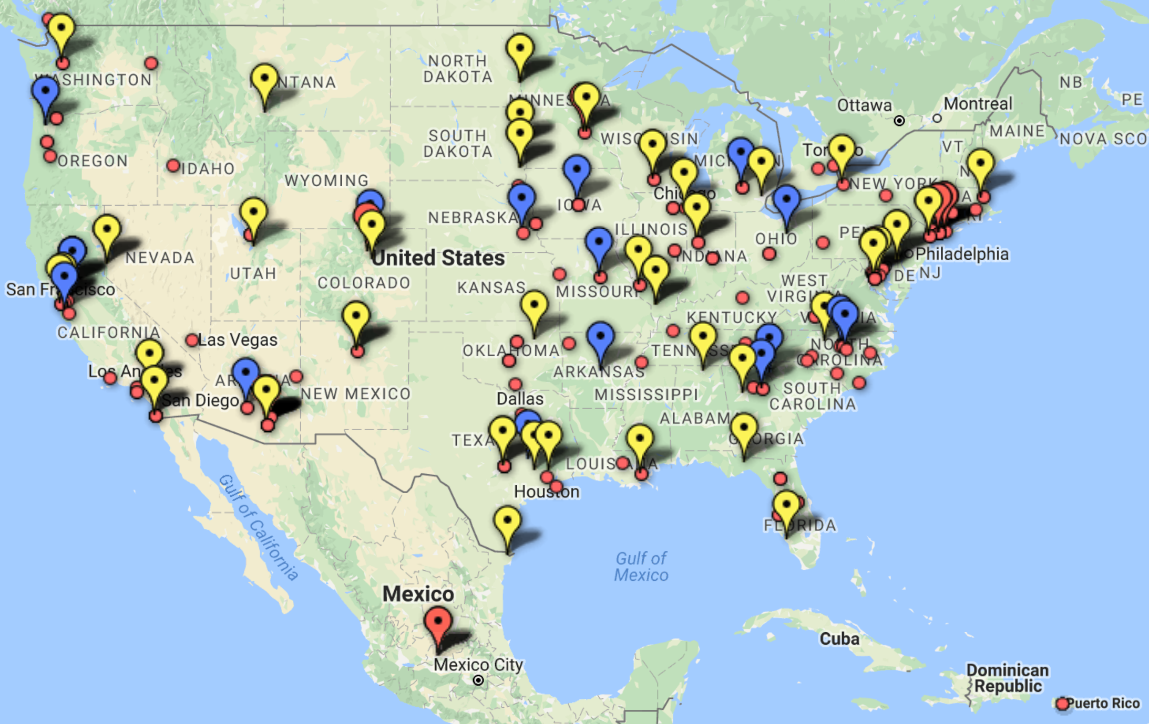
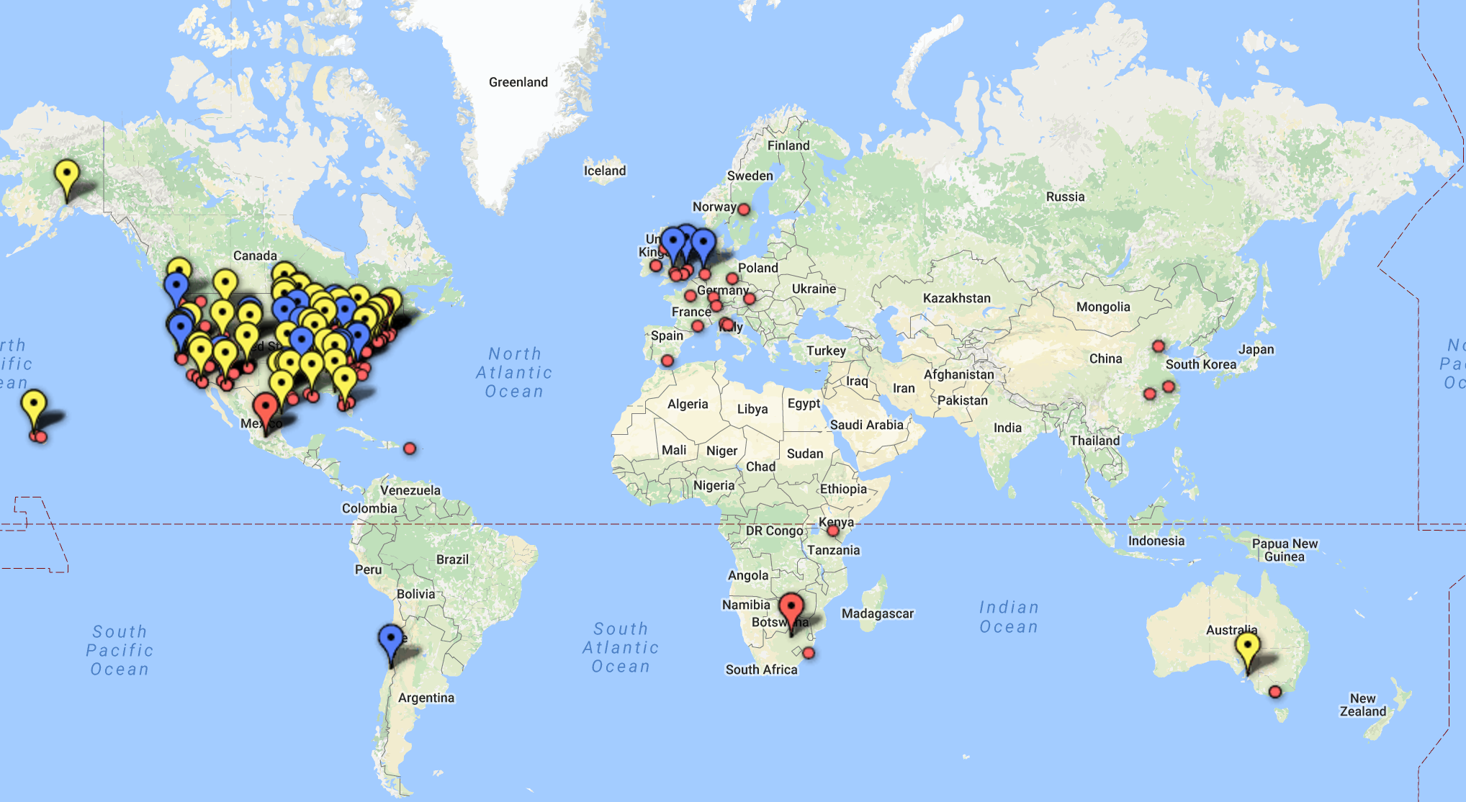
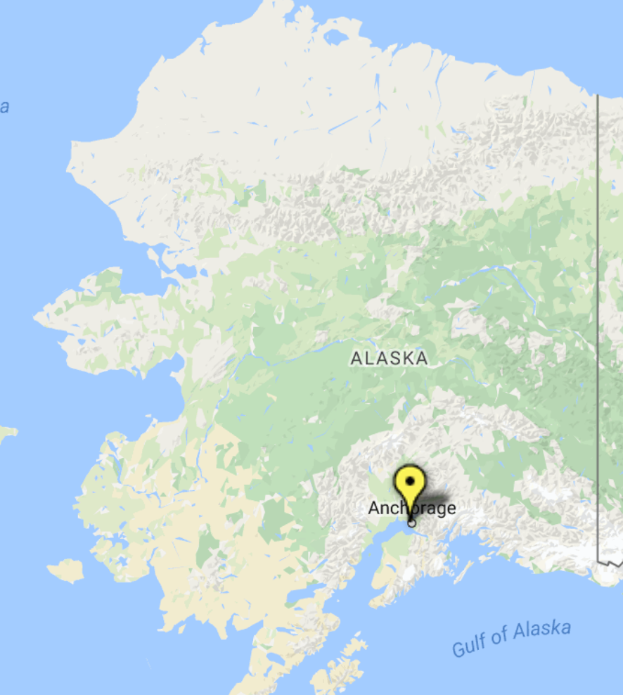
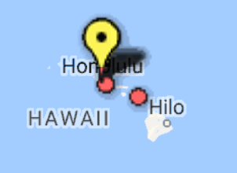
There is help (lots)
CyVerse Workshops can come to you
Two days covering several modular customized lessons
Hands-on learning
Individual consultations

Slide 6


Community-driven learning
Goal: provide basic lab skills for research computing; “get more done in less time and with less pain.”
Goal: provide researchers training on the fundamentals and best practices in data analysis and management.
Scientists teaching scientists
All-volunteer Instructors (>500 world-wide)
Community-maintained lessons
No assumptions of knowledge for learners

Slide 7


Genomics Lesson Narrative
40 Genome sequences (Long-term E.coli evolution experiment)
Organize, summarize, visualize data and metadata
Automating analyses - building a variant calling workflow
Cover the ‘unspoken’ protocols make for effective, reproducible research
Hands-on lessons run from the cloud

Slide 8
Some learning goals
Interacting with Computers
Could Computing
Connecting to remote computing (SSH/PuTTY)
File Transfer (FileZilla, other command-line tools: scp, rsynch, wget, etc. )
Automation and scripting
R scripting
'For' loops
Building automated pipelines
Using multithreaded applications
Data Management and Organization
Open source
Metadata and reproducibility
Important genomics file formats (CSV/TSV, FastQ, SAM/BAM, VCF, etc.)
Organizing a filesystem for computational projects (Linux)
Unix Shell (command-line: ls, cd, mkdir, cp, rm, wc, grep, cut, columns, head, tail, less etc,)
R: Creating projects, scripts, and examining data
Data Cleaning and visualization
R: various packages and functions
R: dplyr
R: ggplot
FastQC - quality control of high-throughput sequence data
Trimmomatic - filtering and trimming of high-throughput sequence data
Integrated Genome Viewer

Slide 9

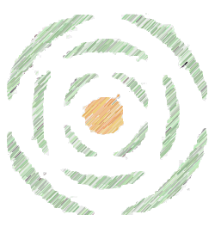
CyVerse Evolution
iPlant 2008
Empowering a New Plant Biology
iPlant 2013
Cyberinfrastructure for Life Science
CyVerse 2016
Transforming Science Through Data-Driven Discovery

Slide 10

CyVerse Evolution
We are funded by the National Science Foundation
We are your colleagues and collaborators!
$100 Million in investment
Freely available to the community
Spur national/international collaboration
Cite CyVerse:
CyVerse.org/acknowledge-cite-cyverse
DBI-0735191 and DBI-1265383

Slide 11
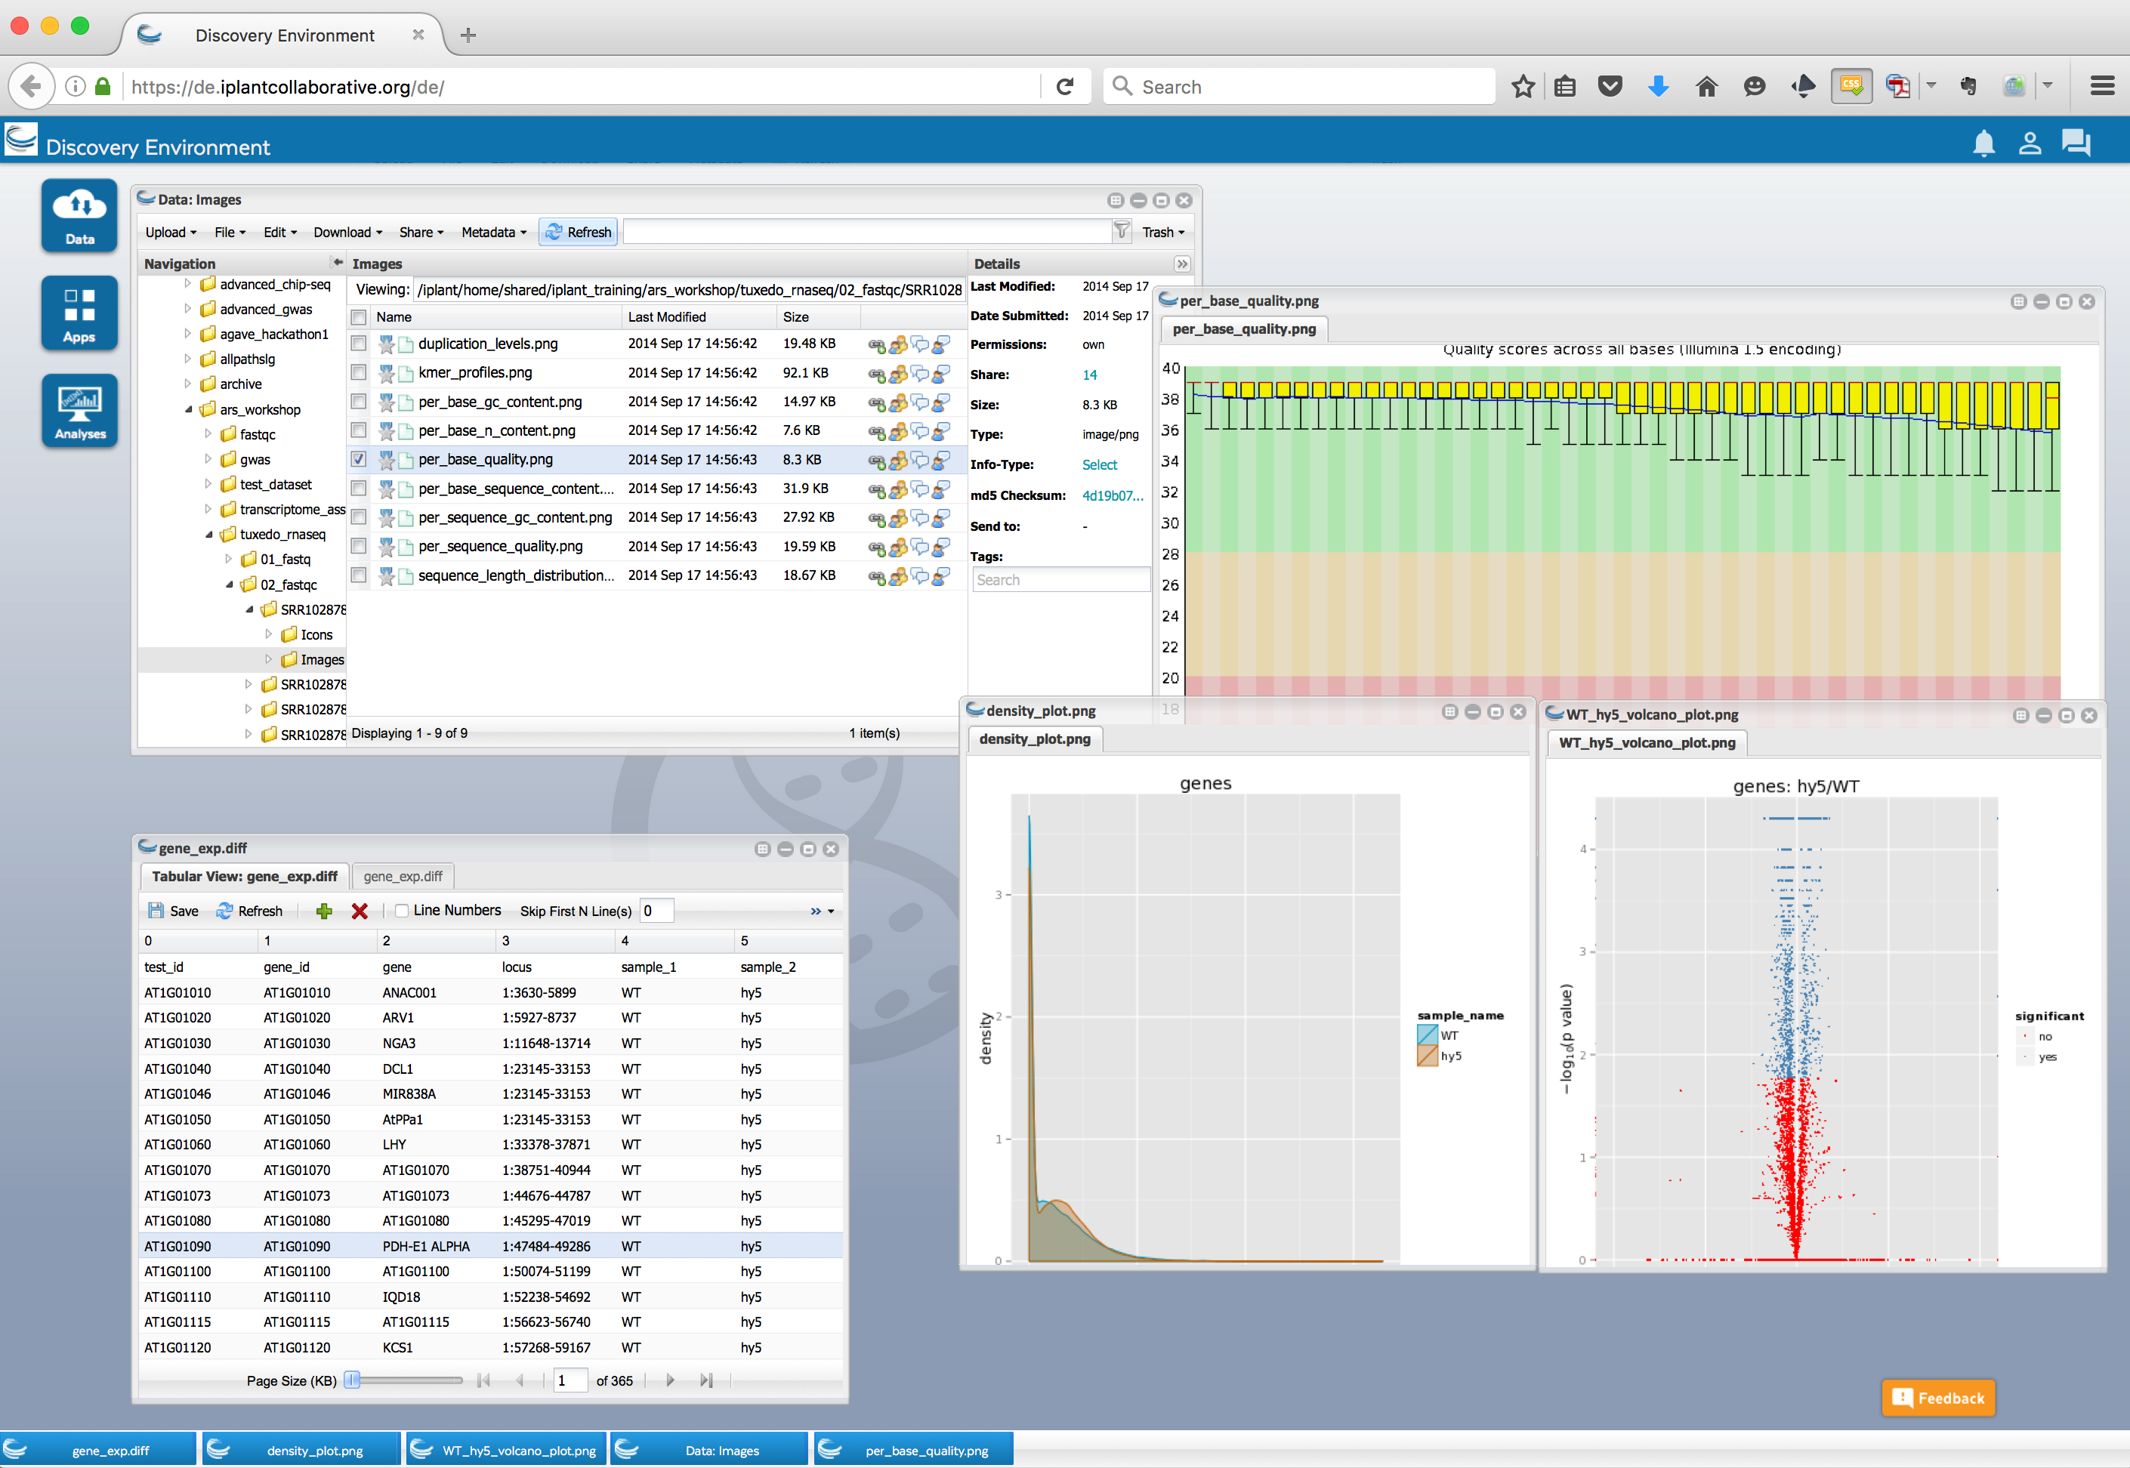
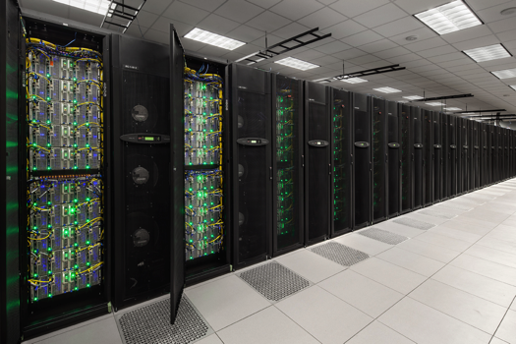

What is Cyberinfrastructure?
Platforms, tools, datasets Storage and compute Training and support

Slide 12
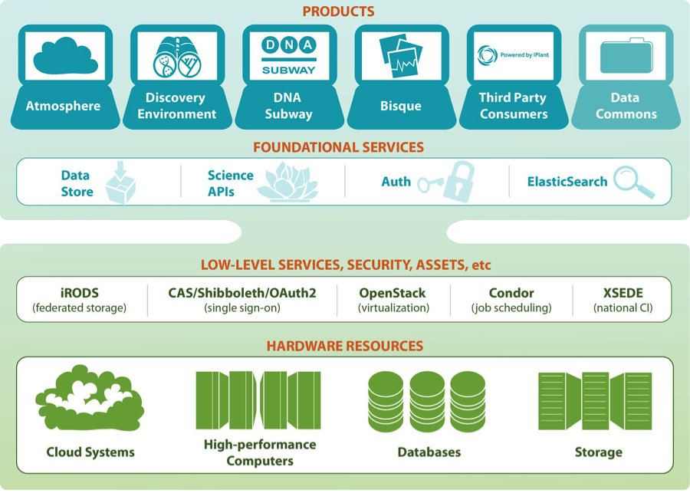
CyVerse product stack
Ready to use Platforms
Extensible Services
Flexibility
Ease of Use
Established CI Components
Foundational Capabilities

Slide 13









CyVerse Institutions
CyVerse is a collaborative virtual organization
CyVerse UK

Slide 14
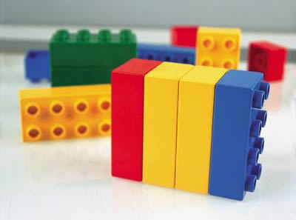
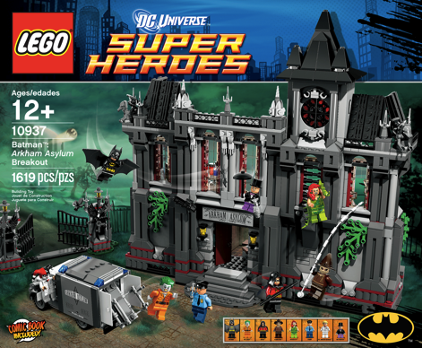
CyVerse Products
We strive to be the CI Lego blocks
Danish 'leg godt' - 'play well’
Also translates as 'I put together' in Latin
If a solution is not available you can craft your own using CyVerse CI components

Slide 15

Data Store
The resources you need to share and manage data with your lab, colleagues and community
Initial 100 GB allocation – TB allocations available
Automatic data backup
Easy upload /download and sharing
Notes:
Focus here is on genomics data, but not restricted to genomics data

Slide 16

Discovery Environment
Hundreds of bioinformatics Apps in an easy-to-use interface
A platform that can run almost any bioinformatics application
Seamlessly integrated with data and high performance computing
User extensible – add your own applications
Notes:
Focus here is on genomics data, but not restricted to genomics data

Slide 17
Atmosphere
Cloud computing for the life sciences
Simple: Access to hundreds of virtual machine images
Flexible: Fully customize your software setup
Powerful: Integrated with CyVerse computing and data resources
Notes:
Focus here is on genomics data, but not restricted to genomics data

Slide 18

Science APIs
Fully customize CyVerse resources
Science-as-a-service platform
Define your own compute, and storage resources (local and CyVerse)
Build your own app store of scientific codes and workflows
Notes:
Focus here is on genomics data, but not restricted to genomics data

Slide 19

DNA Subway
Educational workflows for Genomes, DNA Barcoding, RNA-Seq
Commonly used bioinformatics tools in streamlined workflows
Teach important concepts in biology and bioinformatics
Inquiry-based experiments for novel discovery and publication of data
Notes:
Focus here is on genomics data, but not restricted to genomics data

Slide 20

Bisque
Image analysis, management, and metadata
Secure image storage, analysis, and data management
Integrate existing applications or create new ones
Custom visualization and image handling routines and APIs
Notes:
Focus here is on genomics data, but not restricted to genomics data

Slide 21
Getting Data into CyVerse

Slide 22
CyVerse Data Store
Store any type of file related to your research
Move files seamlessly between CyVerse platforms
Automate file transfers
Share files with lab members, collaborators, and communities

Slide 23
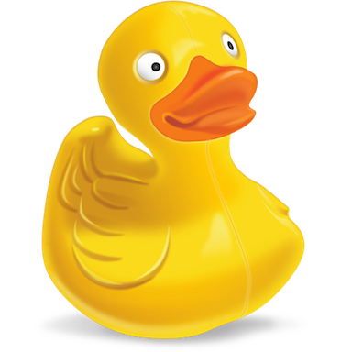
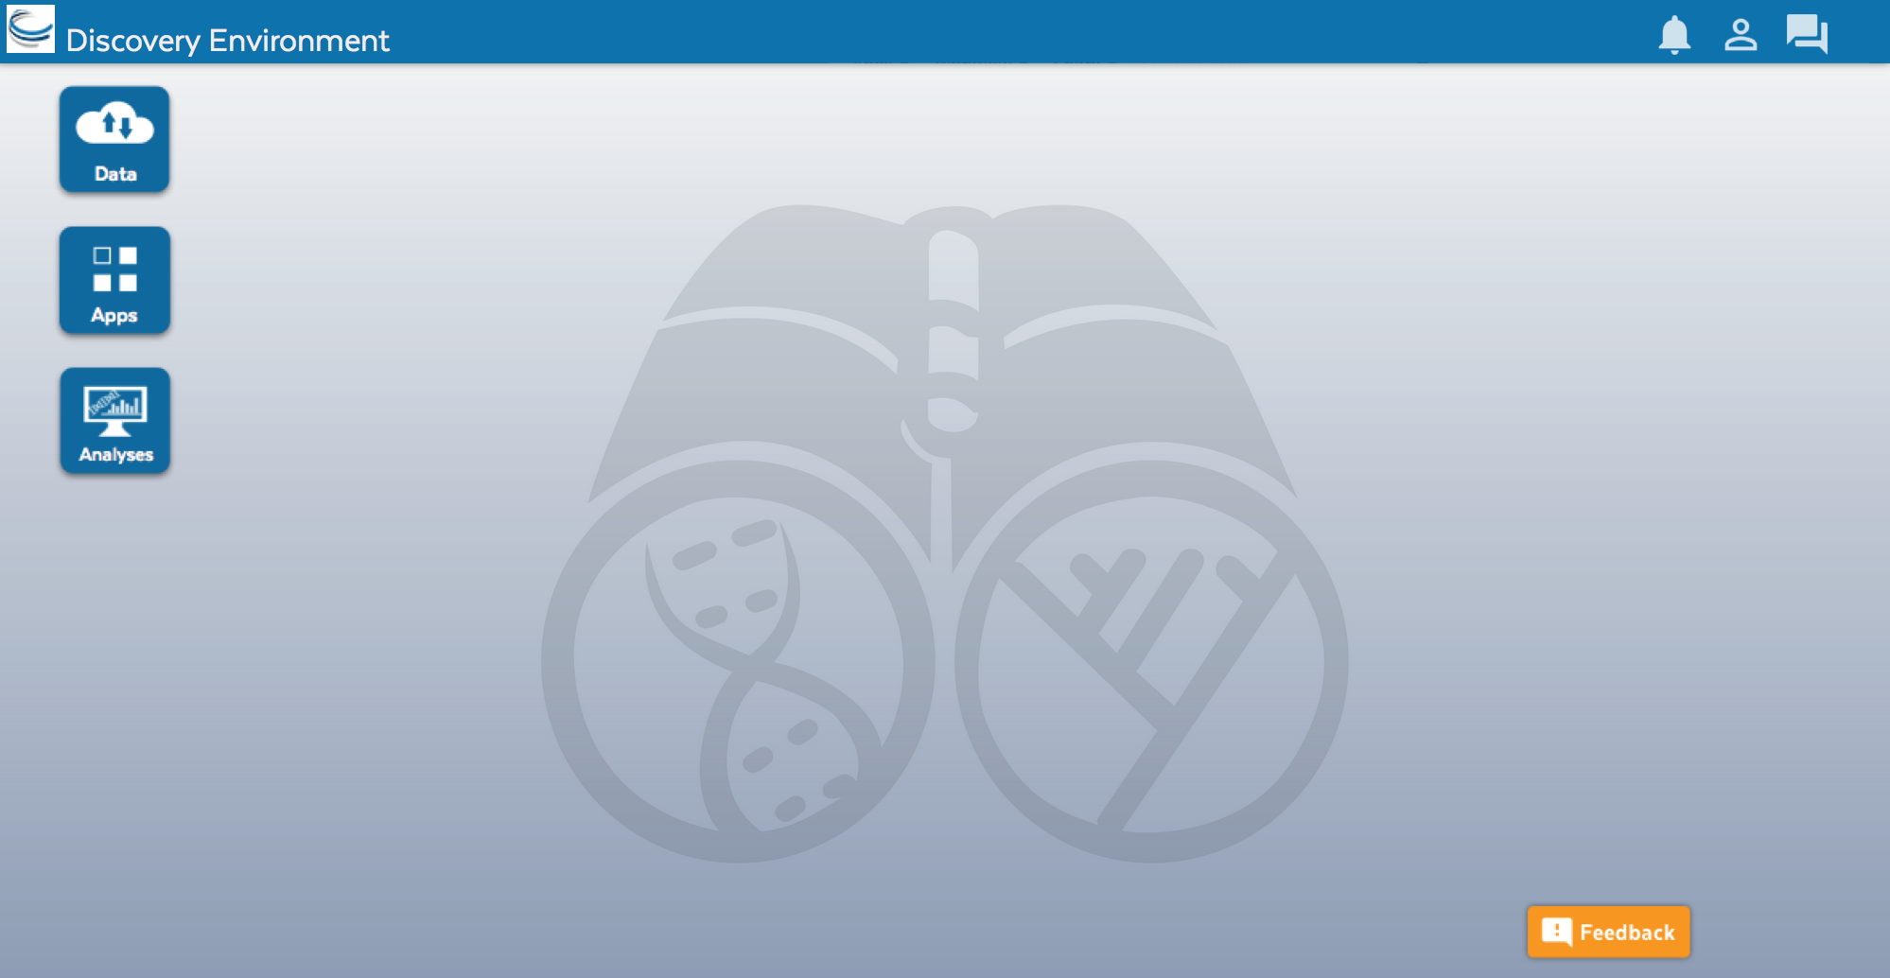
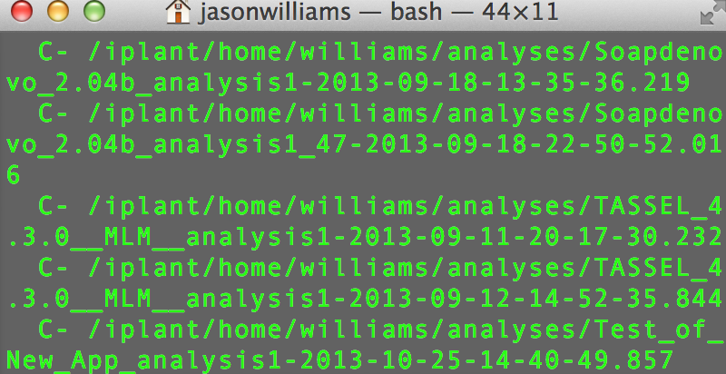
CyVerse Data Store
Multiple ways to access
Point-and-click
Command line
Cyberduck Discovery Environment
iCommands

Slide 24
Discovery Environment
Simple upload/download for small files
Bulk upload files and folders (<10GB)
Import from URL (no size limit)
Advantage + Disadvantage -
Covers most upload/download sharing needs
Some size/speed limitations

Slide 25
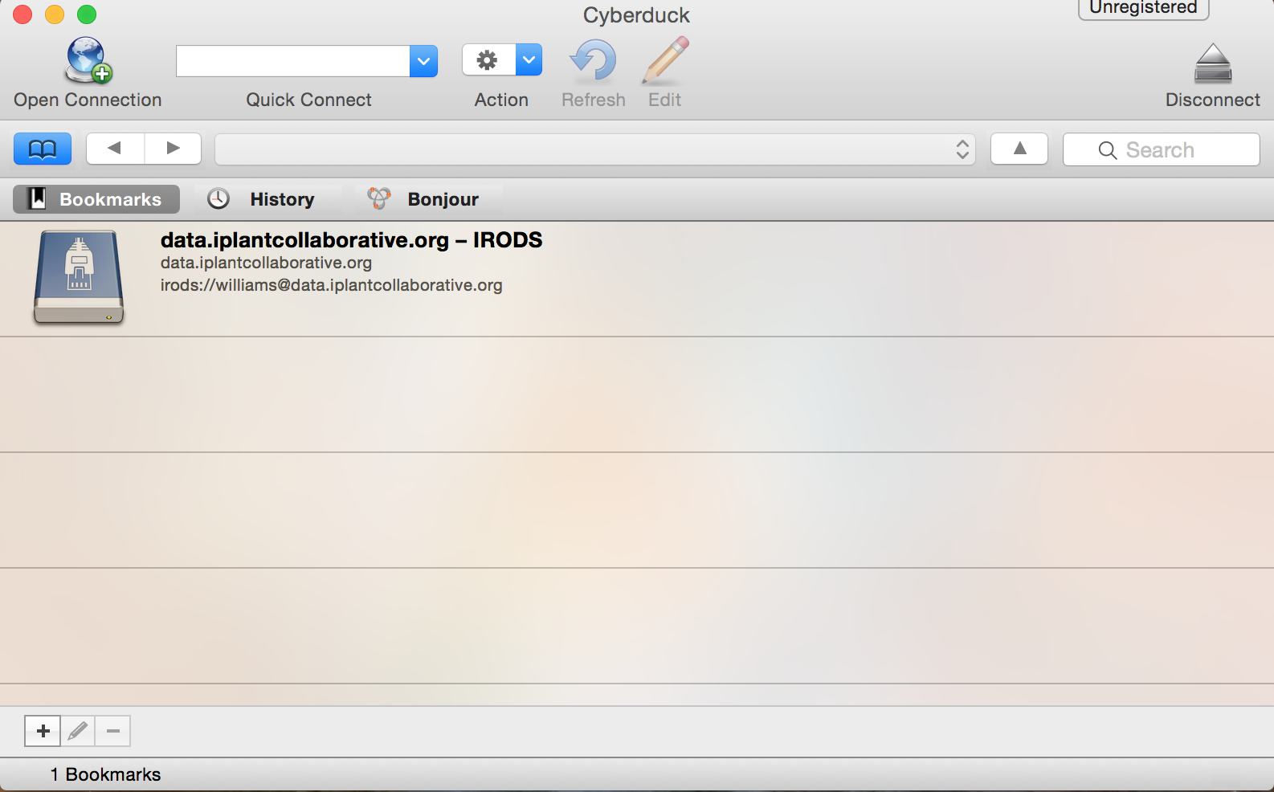
Cyberduck
Drag and drop files and folders
No size limit, file editing/previews
Easy Desktop functionality
Advantage + Disadvantage -
More like desktop file systems
No permissions/metadata control

Slide 26
iCommands
Full flexibility
Ability to script and automate
Access from terminal/server
Advantage + Disadvantage -
Customizability
Requires some command line expertise

Slide 27
Cyberduck and iCommands Demo

Slide 28
Discovery Environment

Slide 29
Discovery Environment
A platform that can run almost any bioinformatics application
Seamlessly integrated with data and high performance computing
User extensible – add your own applications

Slide 30
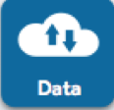
Discovery Environment Overview
Manage data
Data
Upload / Download files and folders
Share files via URL (Public Links)
Share files/folders with other users

Slide 31
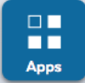
Discovery Environment Overview
Analyze data and customize Applications
Apps
Run hundreds of bioinformatics Apps
Build automated workflows
Modify Apps or integrate new ones

Slide 32
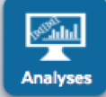
Discovery Environment Overview
View history, find results, reproduce analyses, optimize parameters
Analyses
Monitor job status and find results
Cancel jobs or re-launch jobs
Detailed job history

Slide 33
Discovery Environment Demo

Slide 34
Discovery Environment
Demo analysis – sequence alignment using MUSCLE
Task: Take unaligned DNA sequences in FASTA format and create a multiple alignment
View sample data in Data Store
Launch a job using the MUSCLE sequence alignment app
Monitor the job progress and view results

Slide 35
Atmosphere

Slide 36
Atmosphere
Simple: Access hundreds of virtual machine images
Flexible: Fully customize your software setup
Powerful: Integrated with CyVerse computing and data resources

Slide 37
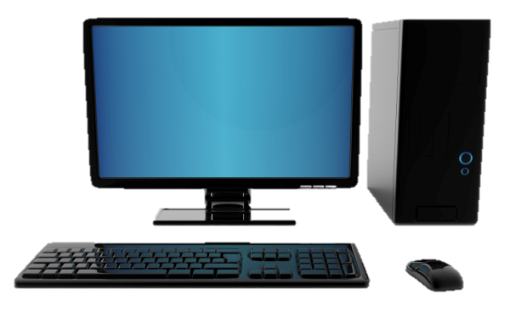


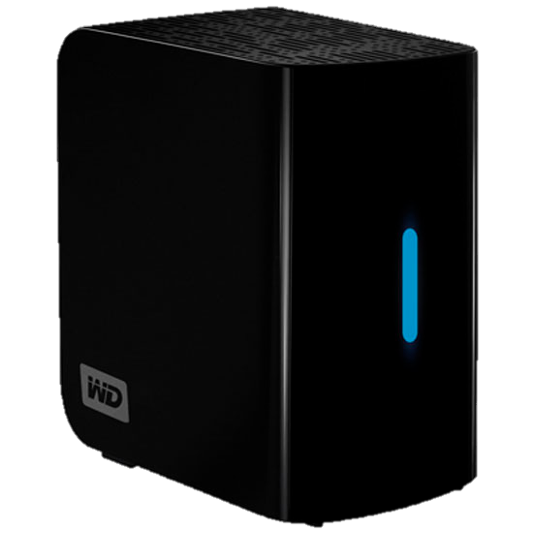
What is Cloud Computing?
Important concepts: Image
Image (file)
Complete clone (files/data)
Original system
Document(s) (file)
Copied Document(s) (file)

Slide 38
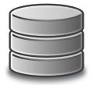
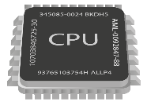
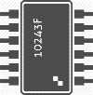
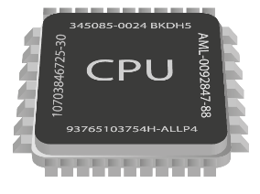

What is Cloud Computing?
Important concepts: Instance
+
(Disk + CPU + Memory) + (Image)
128.196.34.158
CyVerse Cloud
Atmosphere Instance
(virtual machine)

Slide 39
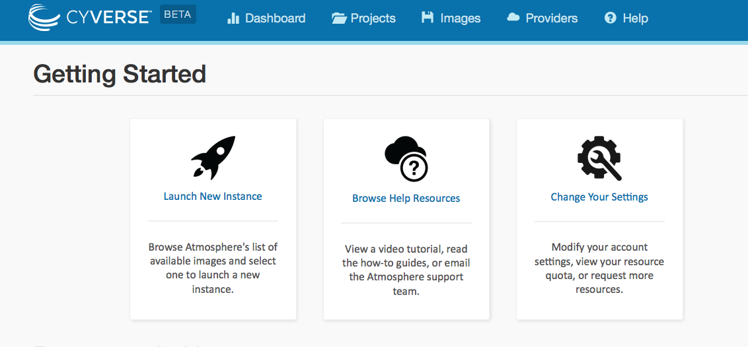
Atmosphere Overview
Largest, easiest to use cloud for Life Sciences
Choose an existing image or customize
Instances up to 16-Core / 128 GB RAM
Access via shell or VNC
Share you image with selected users, or make them public

Slide 40
Atmosphere
Cloud computing for life sciences: sample use cases
Run the software and data that are monopolizing your laptop/desktop
Use desktop enabled images to run visually oriented programs (GUI)
SUDO access – manage complex dependencies
Uniform computing setups for your lab, collaborators, and students
Make your own software available to a larger user community

Slide 41
Atmosphere Demo

Slide 42
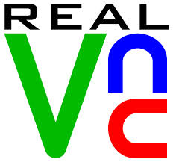
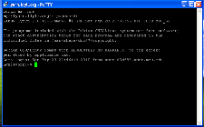
Atmosphere
Cloud computing for life sciences
Windows Mac Linux
VNC Viewer
VNC Viewer
VNC Viewer
PuTTY
Shell/terminal
Shell/terminal
VNC Viewer: www.realvnc.com/download/viewer
PuTTy: www.putty.org

Slide 43
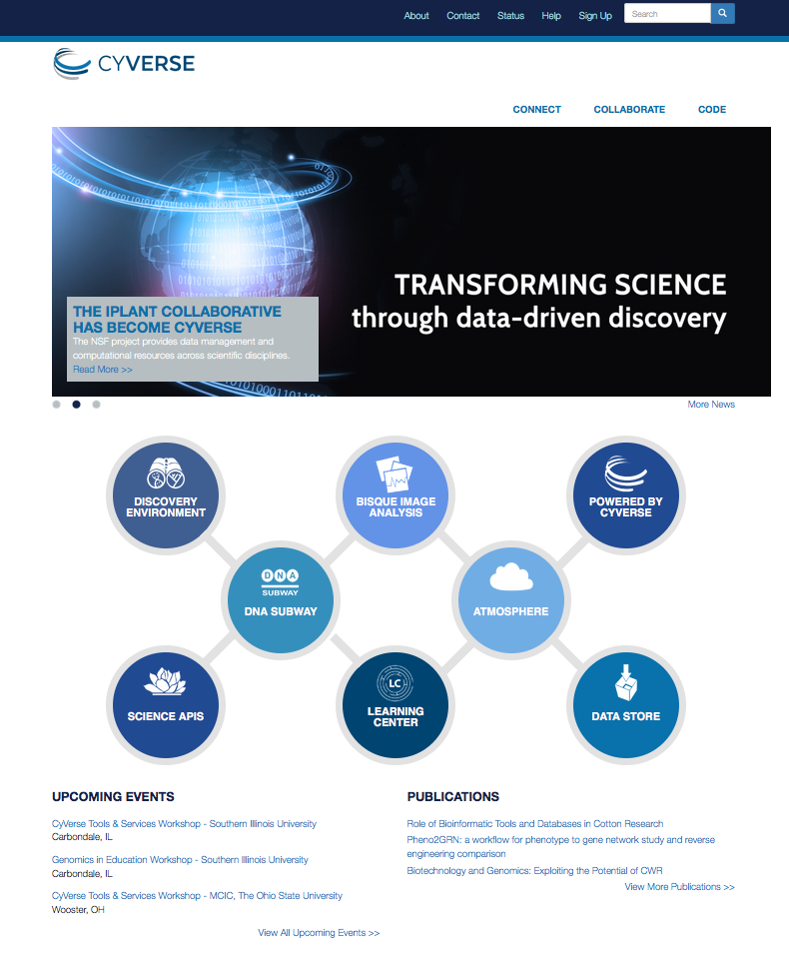
Where to go from here:
Learning Center
Get Started Guide
Tutorials and Videos
Documentation
Upcoming Events
Workshops
Webinars

Slide 45
Slides and Tutorials
www.cyverse.org/cereal2016

